Slide 1


Evaluating the Effectiveness of Online Learning Technologies on Learning Experiences and Outcomes
A Machine Learning-Driven Evaluation
Chanlin Naicker & Ya Wai Thone
10 December 2025

Slide 2

INTRODUCTION
The rise of online and blending learning has transformed how people learn all around the world, accelerated by the 2019 COVID pandemic.
Today, large amounts of data is being generated from the use of Virtual Learning Environments (VLEs) and MOOCs (Massive Open Online Courses) about student behaviour and learning processes .
Despite this surplus of information, predicting student success and understanding learner satisfaction remains complex. Factors such as student engagement, performance, emotions and perceptions, should be considered equally important.
This study aims to bridge the gap between sentiment and learning data to gain a holistic understanding of online learning.

Slide 3



AIM & OBJECTIVES
Develop accurate and explainable machine learning and natural processing models that predict academic performance outcomes and analyse learner sentiment in online education platforms.
Use data-driven insights to assist educators, course coordinators, educational organizations and even data designers to adapt and tailor educational content that is personalized and supports the needs of students.
Predict different student performance across multiple classes with machine learning approaches using the OULAD dataset and evaluating each of the supervised learning algorithms
Analyse student sentiment towards MOOCs using an NLP techniques to Coursera data.
Examine the relationships between student engagement, sentiments and academic results.
Provide actionable insights to enable early intervention, improve retention and allow personalised learning strategies.

Slide 4







KDD METHODOLOGY
Data collection, data cleaning, exploratory data analysis, model creation, and model deployment make up the core components of the data science life cycle.
Overview of OULAD Dataset
OULAD
OULAD
The Open University Learning Analytics Dataset (OULAD) is a comprehensive repository of student data from the 2013–2014 academic year, encompassing demographic details, assessment results, and virtual learning environment (VLE) interactions.
OULAD consists of 32,593 students participating in 22 distinct module presentations. The dataset is organized into seven CSV files, each capturing student engagement, from demographic profiles to daily activity logs.
Overview of Coursera Dataset
Coursera dataset is instrumental for sentiment analysis. It features labeled reviews that categorize sentiment, serving as a critical resource for developing multi-class sentiment prediction models, thus enhancing understanding of learner experiences.
It consists of three columns - Id, Review, Label consisting of a total of 107018 rows.
Data Sourcing

Slide 5



KDD METHODOLOGY
OULAD
studentAssessment
studentInfo
studentVLE
asssessment
studentRegistration
vle
courses
Structural Analysis of Raw Datasets
Data Merging and Assessment Recalculation
Handling Missing and Inconsistent Entries
Activity and Behavioural Feature Engineering
Merged OULAD
OULAD
Data Sourcing
Data Merging
Clips

Slide 6
KDD METHODOLOGY
OULAD
Data Cleaning
Minimal Text Pre-processing
Data Cleaning: removed duplicates & very short text, filtered non-English reviews
Light Preprocessing (BERT-Compatible): removed URLs and noise; no stopword removal or lemmatisation to preserve contextual information.​
Sentiment Labelling: ratings 1–2 = negative, 3 = neutral, 4–5 = positive; natural class distribution kept with no resampling.​
Tokenisation: applied DistilBERT WordPiece tokenizer to generate token IDs and attentionmasks for model input.
Sentiment Labelling
Tokenization
OULAD
Data Sourcing
Data Merging
Text Pre-Processing
Sadness is literally the very definition and being of sorrow and gloom. She was hardly ever used because Joy is the dominant emotion and didn't want Riley to ever be sad. Because of this, Joy treated Sadness poorly.
Clips

Slide 7

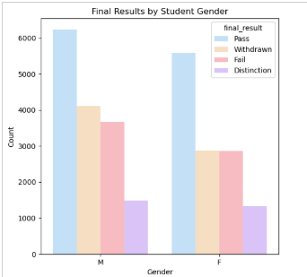
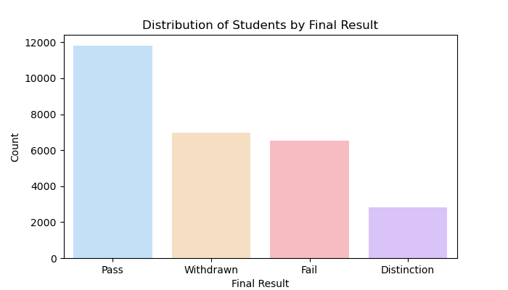
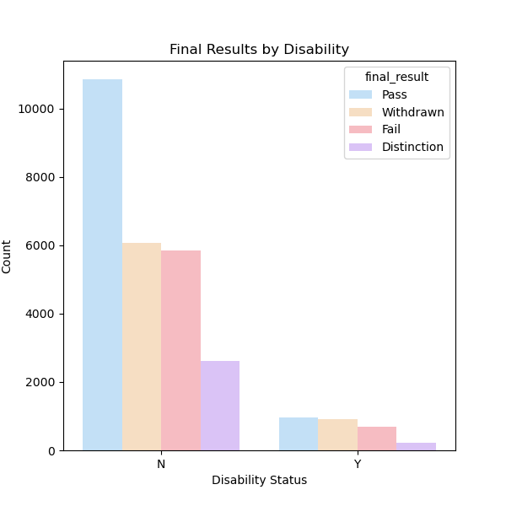
KDD METHODOLOGY
OULAD
Gender
Final Results
Disability Status
OULAD
Data Sourcing
Data Merging
Text Pre-Processing
Exploratory Analysis
Sadness is literally the very definition and being of sorrow and gloom. She was hardly ever used because Joy is the dominant emotion and didn't want Riley to ever be sad. Because of this, Joy treated Sadness poorly.
Clips

Slide 8
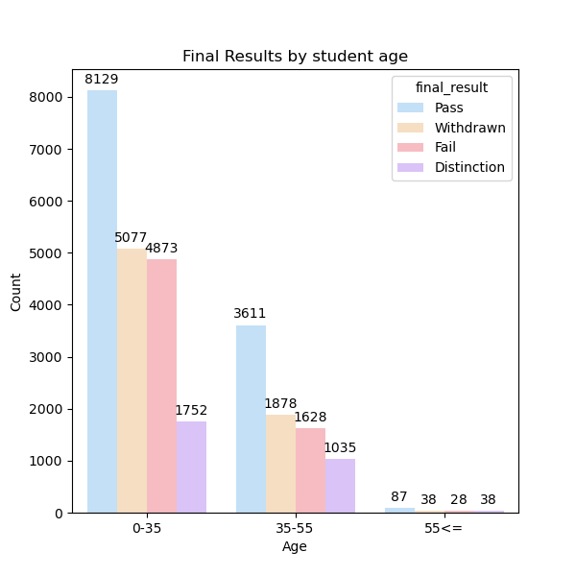
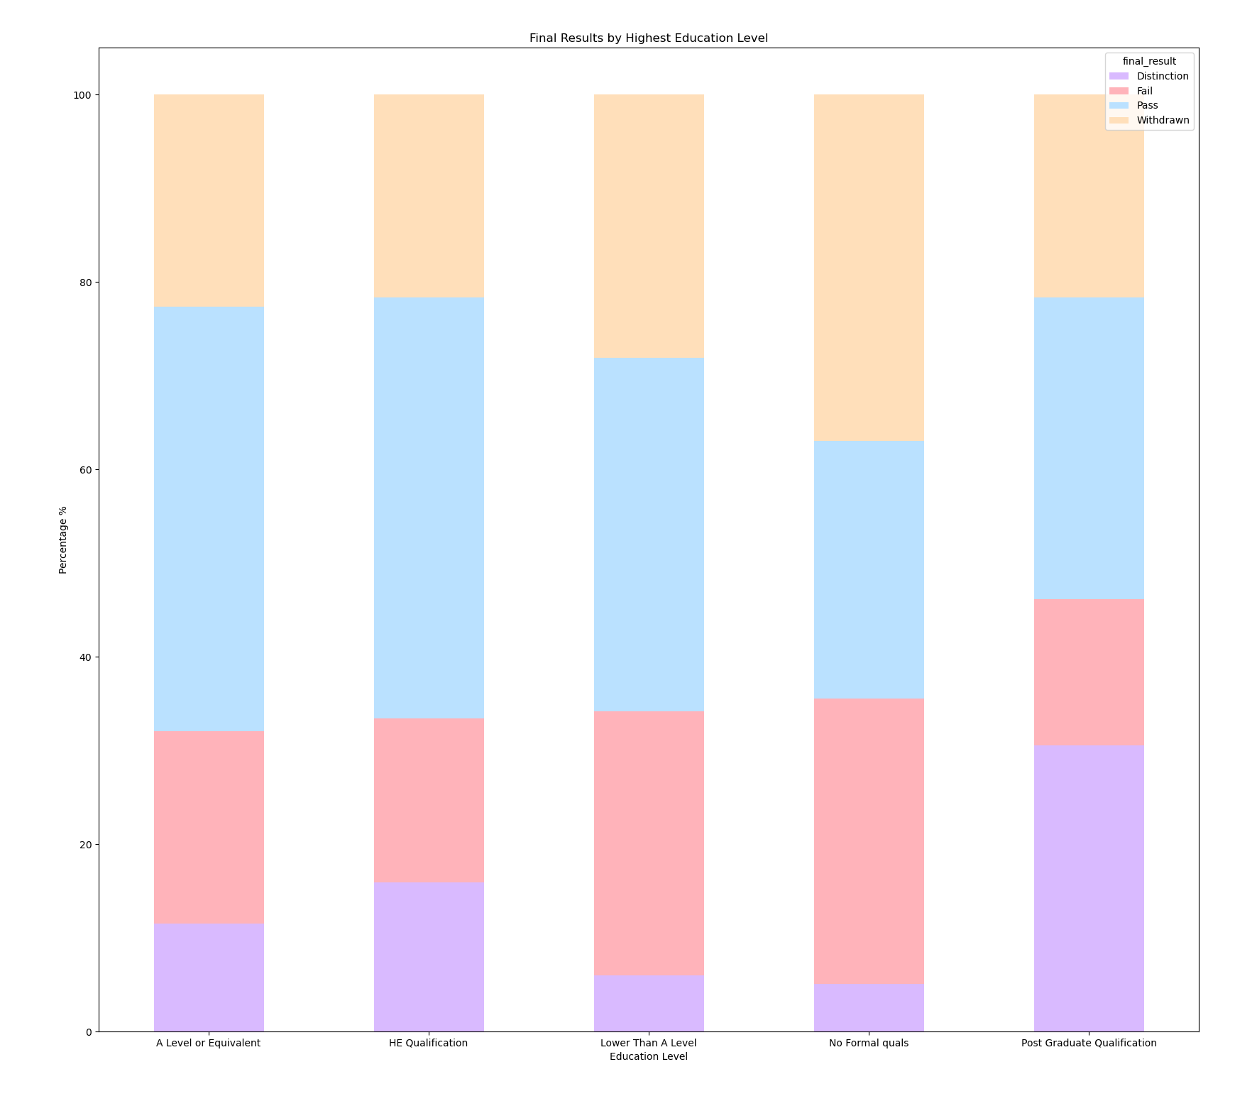
KDD METHODOLOGY
Age
OULAD
OULAD
Highest Education Level
Data Sourcing
Data Merging
Text Pre-Processing
Exploratory Analysis
Sadness is literally the very definition and being of sorrow and gloom. She was hardly ever used because Joy is the dominant emotion and didn't want Riley to ever be sad. Because of this, Joy treated Sadness poorly.
Clips

Slide 9
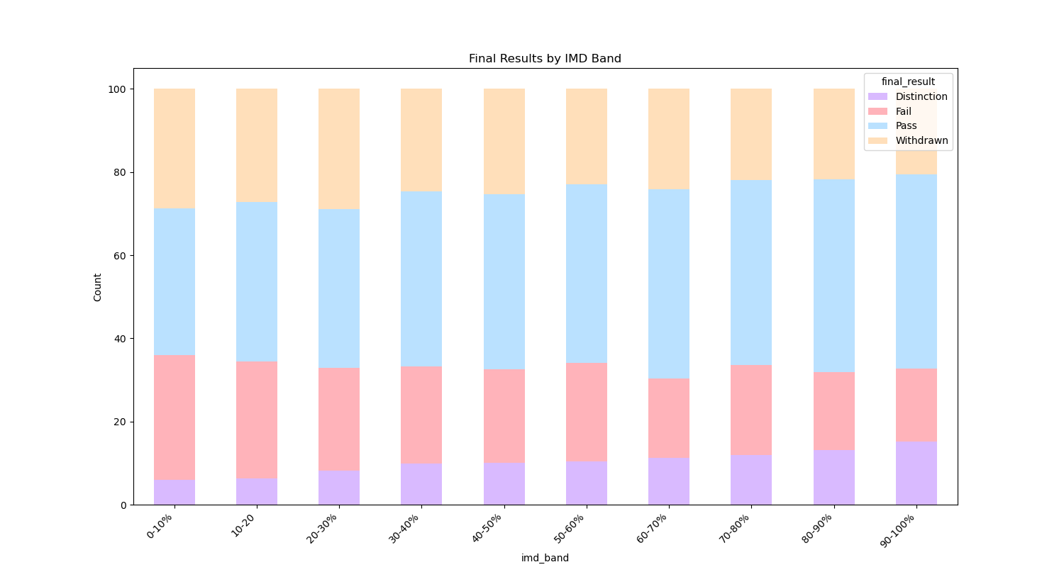
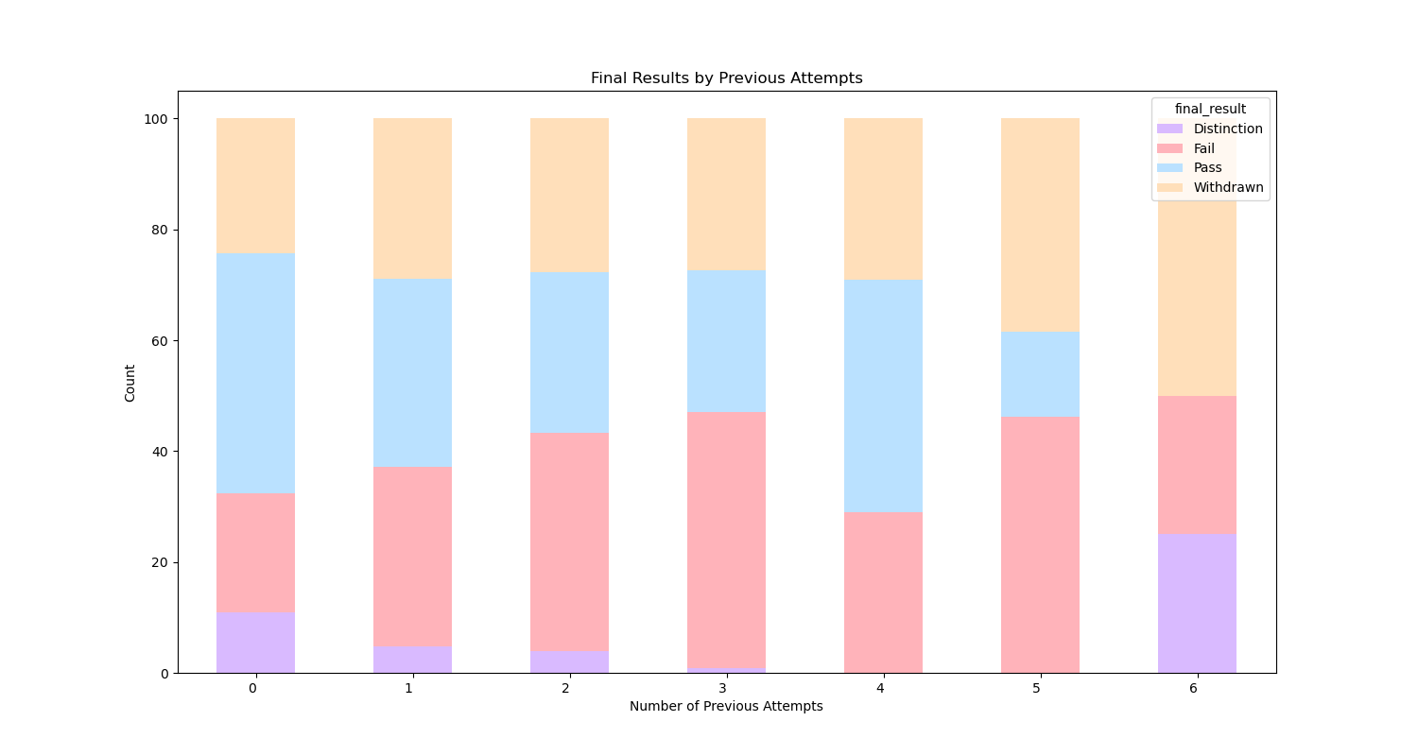
KDD METHODOLOGY
IMD Band
OULAD
Number of Previous Attempts
OULAD
Data Sourcing
Data Merging
Text Pre-Processing
Exploratory Analysis
Sadness is literally the very definition and being of sorrow and gloom. She was hardly ever used because Joy is the dominant emotion and didn't want Riley to ever be sad. Because of this, Joy treated Sadness poorly.
Clips

Slide 10
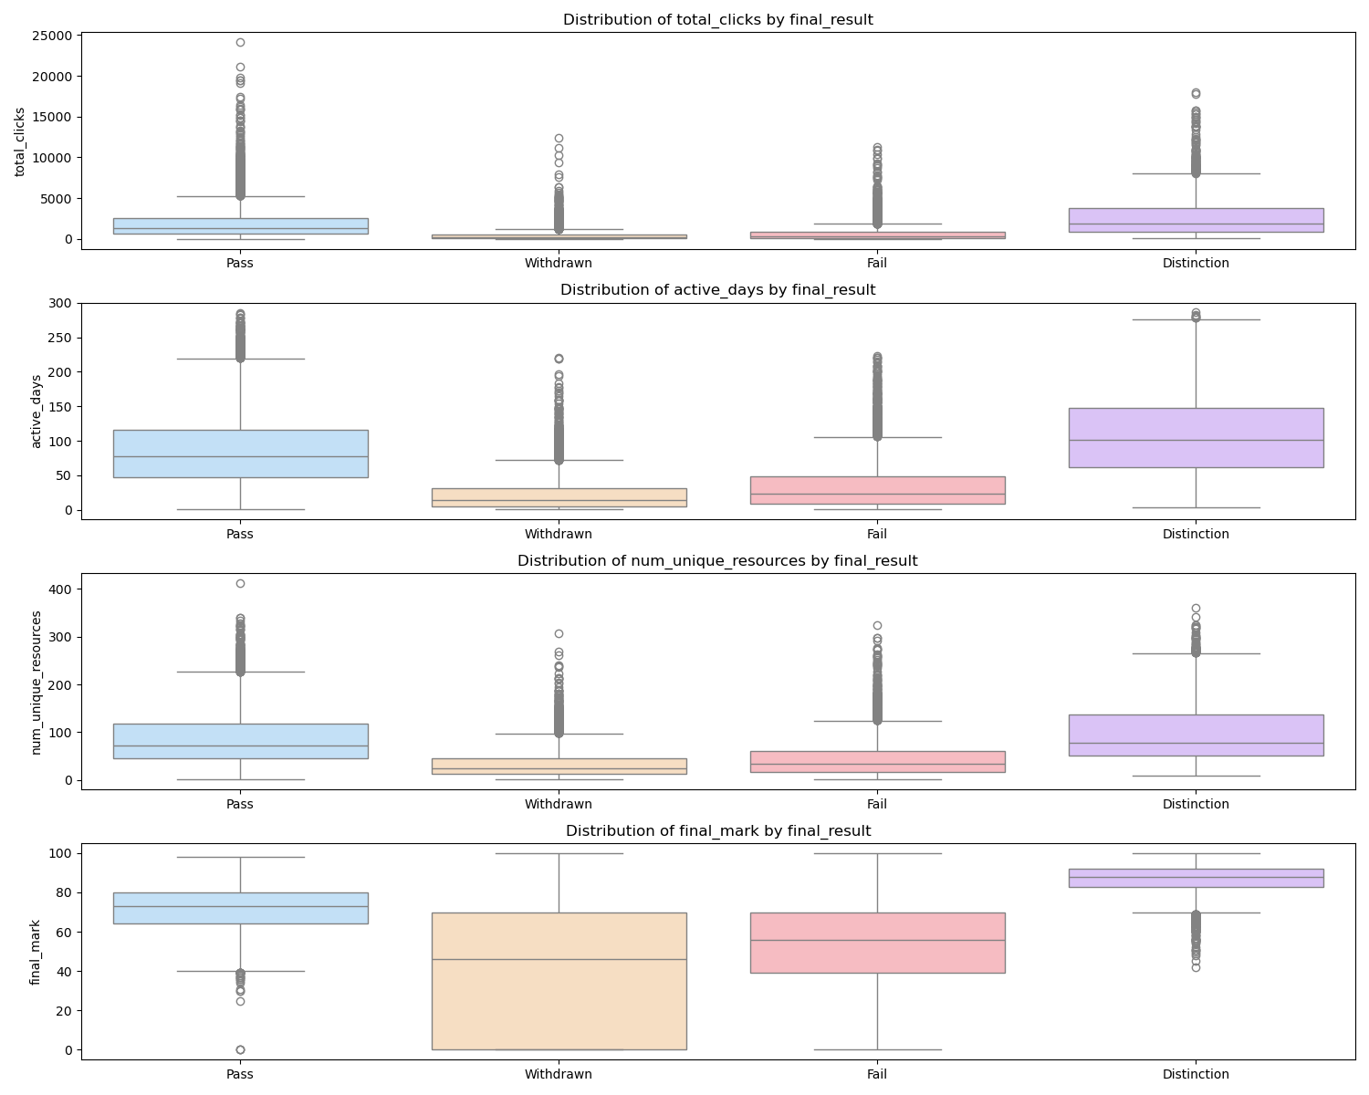
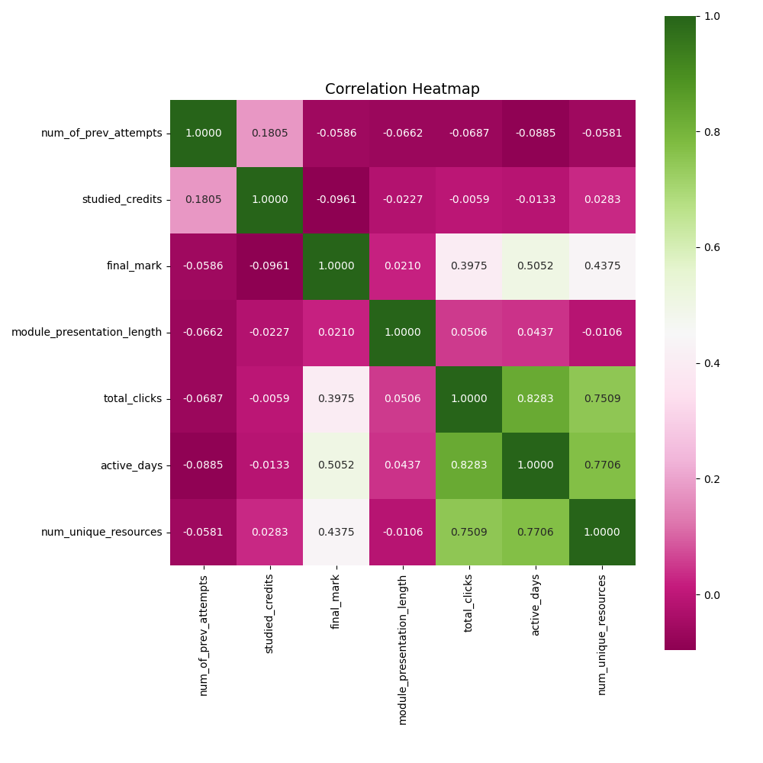
KDD METHODOLOGY
Total Clicks
Days Active
Unique Resources Accessed
Marks Achieved
OULAD
OULAD
Data Sourcing
Data Merging
Text Pre-Processing
Exploratory Analysis
Sadness is literally the very definition and being of sorrow and gloom. She was hardly ever used because Joy is the dominant emotion and didn't want Riley to ever be sad. Because of this, Joy treated Sadness poorly.
Clips

Slide 11
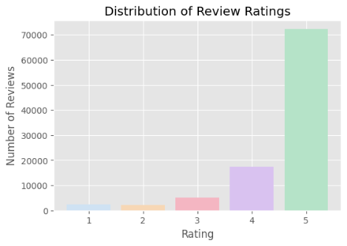
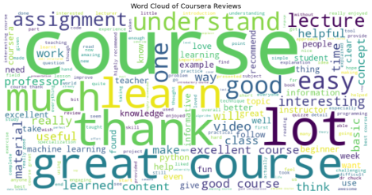
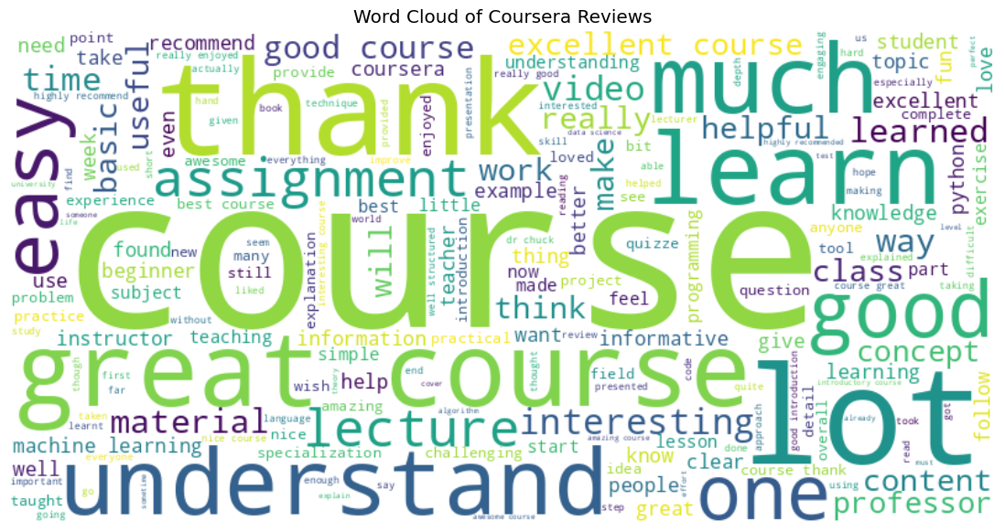
KDD METHODOLOGY
OULAD
OULAD
Data Sourcing
Data Merging
Text Pre-Processing
Exploratory Analysis
Sadness is literally the very definition and being of sorrow and gloom. She was hardly ever used because Joy is the dominant emotion and didn't want Riley to ever be sad. Because of this, Joy treated Sadness poorly.
Clips

Slide 12



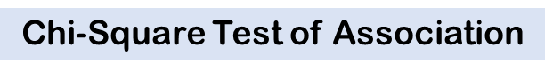
KDD METHODOLOGY
Categorical Encoding: One-hot encoding on all categorical variables (including the four outcome variables) was applied to convert them into a machine-readable numerical format.
Feature scaling: Numeric variables were scaled using Scikit-learn's StandardScaler depending on model application.
Data split and stratification: Data was split into 70:30 partition for training and testing for OULAD and 80:20 to Coursera. It allows DistilBERT to learn rich contextual patterns. Stratification was used for equal representation.
Variable | 𝝌𝟐 value | Significance
Code_Module | 1493.976 | <.0001
Code_Presentation | 345.696 | <.0001
Gender | 76.058 | <.0001
Region | 278.761 | <.0001
Highest_Education | 867.330 | <.0001
Imd_Band | 545.805 | <.0001
Age_Band | 196.918 | <.0001
Disability | 138.918 | <.0001
*all variables were significant at a 5% level of significance
Data Preprocessing and Feature Engineering
Feature Selection
Data Sourcing
Data Merging
Text Pre-Processing
Exploratory Analysis
Sadness is literally the very definition and being of sorrow and gloom. She was hardly ever used because Joy is the dominant emotion and didn't want Riley to ever be sad. Because of this, Joy treated Sadness poorly.
Clips

Slide 13
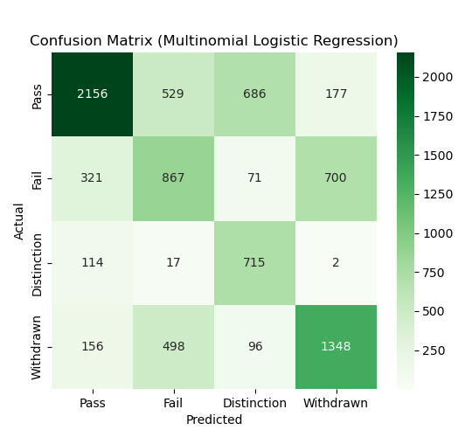
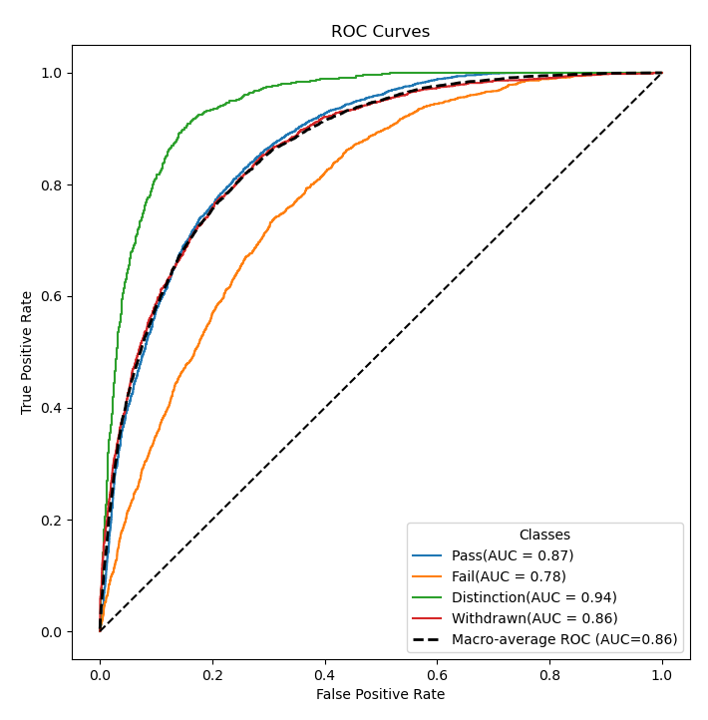
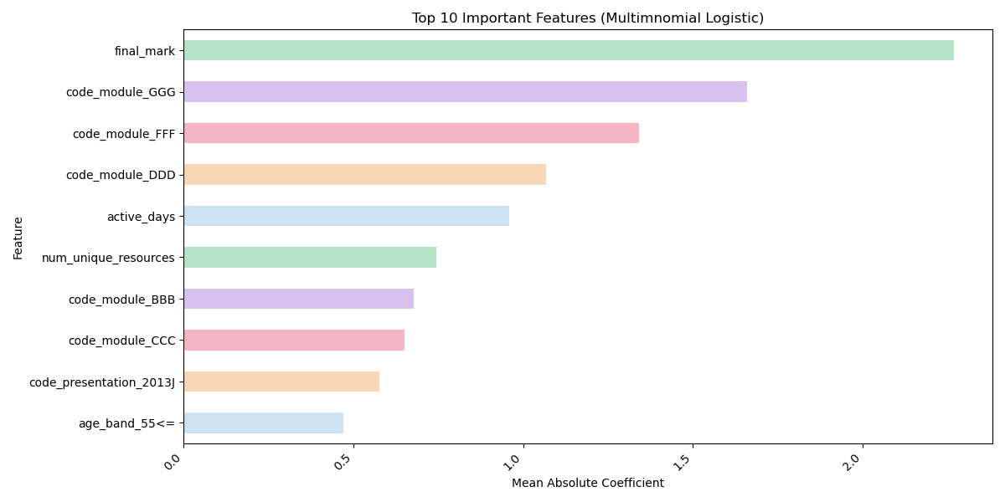
Model Building
RESULTS
ROC CURVE + AUC
Multinomial
Logistic Regression
CONFUSION MATRIX
Metric | Score
Accuracy | 0.602
Precision (macro) | 0.575
Sensitivity/Recall (macro) | 0.634
Specificity | 0.867
Cohen's Kappa | 0.452
MCC | 0.458
F1 Score | 0.587
ROC AUC (macro) | 0.863
Feature Coefficients
OULAD

Slide 14
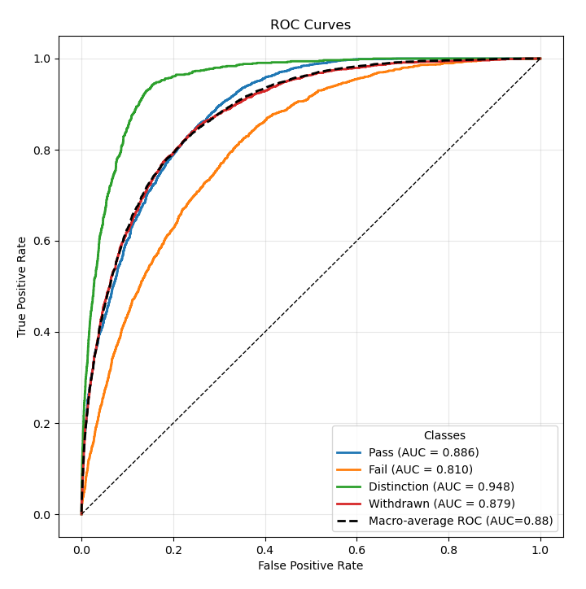
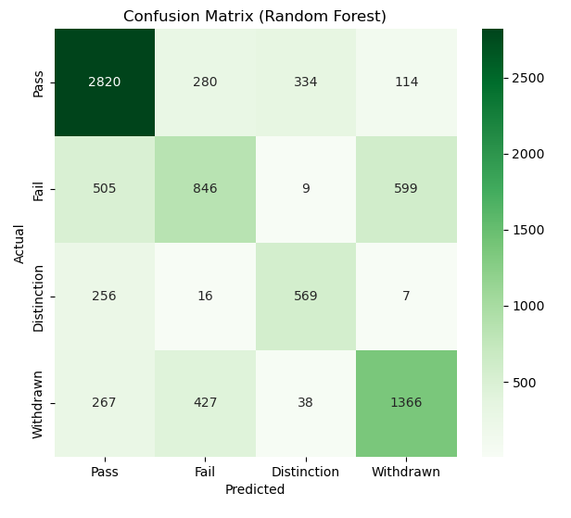
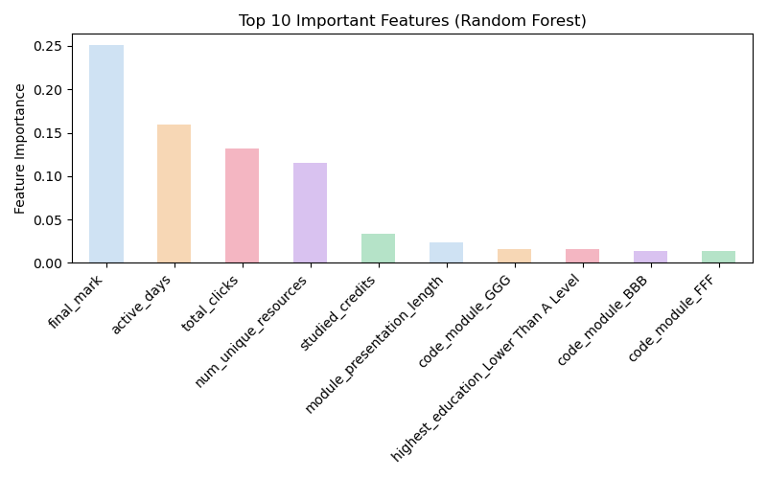
CONFUSION MATRIX
RESULTS
Random Forest
Metric | Score
Accuracy | 0.663
Precision (macro) | 0.631
Sensitivity/Recall (macro) | 0.637
Specificity | 0.867
Cohen's Kappa | 0.513
MCC | 0.515
F1 Score | 0.632
ROC AUC (macro) | 0.880
ROC CURVE + AUC
Feature Importance
OULAD

Slide 15
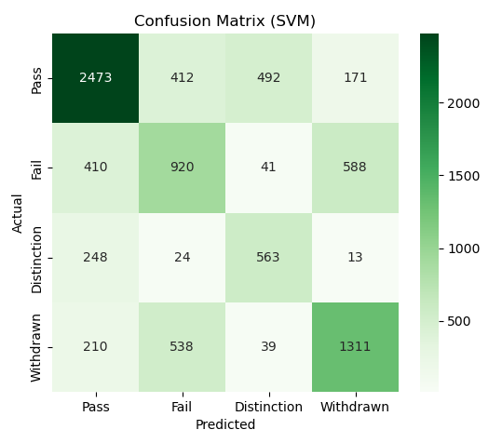
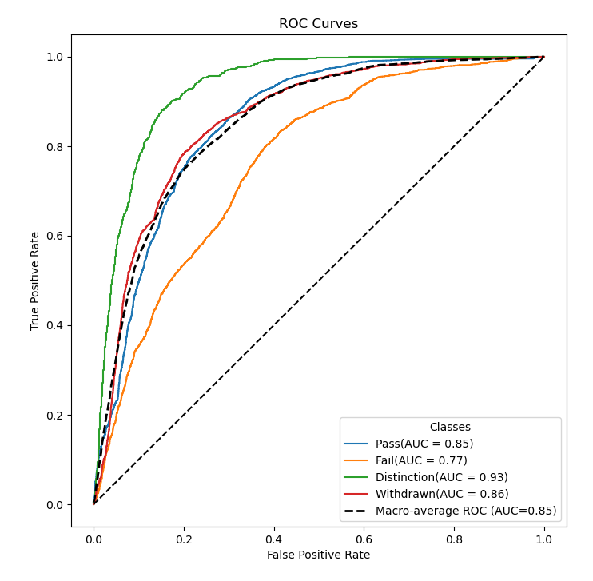
RESULTS
ROC CURVE + AUC
Support Vector Machine (SVM)
Metric | Score
Accuracy | 0.623
Precision (macro) | 0.588
Sensitivity/Recall (macro) | 0.614
Specificity | 0.869
Cohen's Kappa | 0.467
MCC | 0.468
F1 Score | 0.598
ROC AUC (macro) | 0.851
CONFUSION MATRIX
OULAD

Slide 16
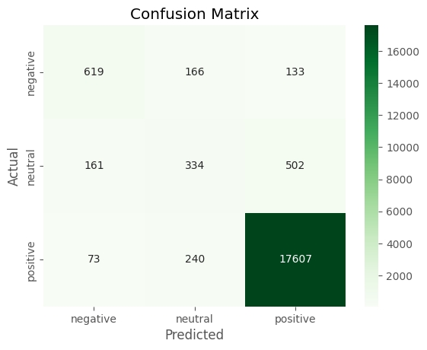
RESULTS
DistilBERT Sentiment Classifier
For the Coursera dataset, a transformer-based approach using DistilBERT proved highly effective in classifying student feedback into positive, neutral, or negative sentiments.
Metric | Score
Accuracy | 0.935
Precision (macro) | 0.713
Sensitivity/Recall (macro) | 0.673
Cohen's Kappa | 0.617
MCC | 0.619
F1 Score (macro) | 0.690
CONFUSION MATRIX
The model effectively captured nuanced linguistic information from real-life review texts.
OULAD

Slide 17
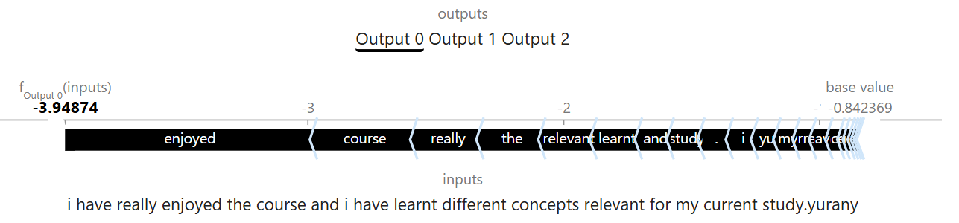
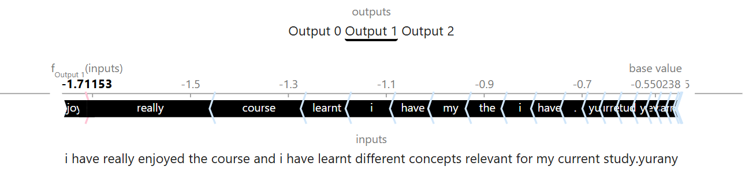
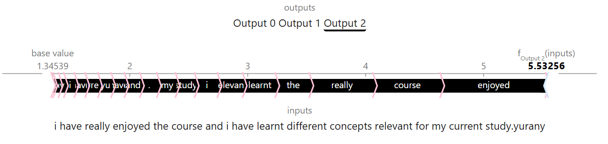
RESULTS
DistilBERT Sentiment Classifier
Model Interpretability Using SHAP – by taking one sample review text from the dataset
Negative
Negative (Output 0): The prediction shifts from the base value to a strongly negative final score, showing the model confidently rejects negative sentiment.
Neutral (Output 1): The output remains close to the base value, indicating weak support for neutrality.
Positive (Output 2): The prediction moves from the base value to a high final positive score, driven mainly by words such as “enjoyed” and “really”, confirming high confidence in positive sentiment.
Neutral
Positive
OULAD

Slide 18
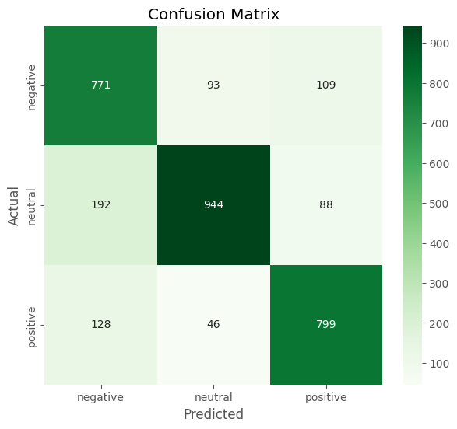
RESULTS
Multi-class Naive Bayes Sentiment Classifier
For the Coursera dataset, a VADER lexicon approach using Multi-class Naives Bayes proved suitable in the classification of multi-class sentiment provided that balancing and preprocessing are done appropriately.
Metric | Score
Accuracy | 0.793
Precision (macro) | 0.793
Sensitivity/Recall (macro) | 0.794
Cohen's Kappa | 0.689
MCC | 0.691
F1 Score (macro) | 0.793
CONFUSION MATRIX
OULAD

Slide 19
DISCUSSION
Random Forest
Support Vector Machine (SVM)
Logistic Regression
 | Accuracy | Precision (macro) | Sensitivity/Recall (macro) | Specificity | Cohen's Kappa | MCC | F1 Score | ROC AUC (macro)
Multinomial Logistic Regression | 0.602 | 0.575 | 0.634 | 0.867 | 0.452 | 0.458 | 0.587 | 0.863
Random Forest | 0.663 | 0.631 | 0.637 | 0.867 | 0.513 | 0.515 | 0.632 | 0.880
SVM | 0.623 | 0.588 | 0.614 | 0.869 | 0.467 | 0.468 | 0.598 | 0.851

Slide 20
In this study, we explored the application of machine learning techniques to predict student performance and sentiment using two distinct datasets: OULAD and Coursera. Our primary goal was to identify methods that could accurately improve predictability on complex data with multiple outcome classes, ultimately aiming to strengthen educational systems for student benefit.
CONCLUSION + COLLABORATION
Leveraging ML for more accurate forecasts of student outcomes.
Addressing challenges in multi-class classification within educational datasets.
Enhanced Predictability
Complex Data Handling
Strategic Model Selection
Testing diverse models to assess their effectiveness across varying complexities.

Slide 21

MOVING FORWARD
This study underscores the importance of adaptive, personalized, and responsive learning experiences in the evolving era of e-learning. Further research could explore ​:
Advanced Feature Engineering and Selection : Explore advanced feature selection techniques to improve prediction performance. Apply dimensionality reduction methods such as PCA to uncover patterns
Model enhancements : Extensive hyperparameter tuning for these models. Use of deep learning models.
Data expansion : Merge additional datasets. Explore cross-interaction student behaviour patterns.

Slide 22
THANK YOU​

